Slide 1
This Pointer
Every object in C++ has access to its own address through an important pointer called this pointer. The this pointer is an implicit parameter to all member functions. Therefore, inside a member function, this may be used to refer to the invoking object.

Slide 2
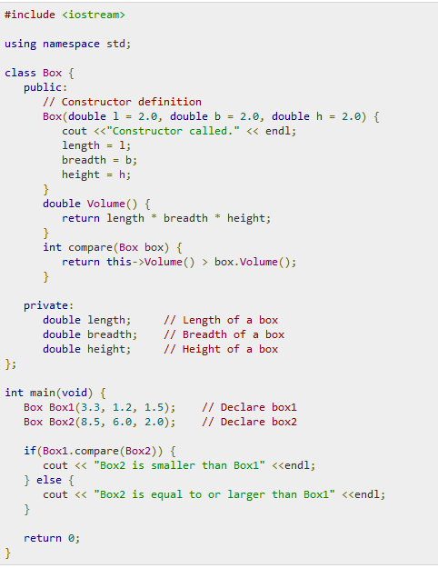

Slide 3
Constant Variables
If you make any variable as constant, using const keyword, you cannot change its value. Also, the constant variables must be initialized while they are declared.
int main
{
const int i = 10;
const int j = i + 10; // works fine
i++; // this leads to Compile time error
}
In the above code we have made i as constant, hence if we try to change its value, we will get compile time error. Though we can use it for substitution for other variables.

Slide 4
Defining Class Data members as const
These are data variables in class which are defined using const keyword. They are not initialized during declaration. Their initialization is done in the constructor.
In this program, i is a constant data member, in every object its independent copy will be present, hence it is initialized with each object using the constructor. And once initialized, its value cannot be changed.
class Test{
const int i;
public:
Test (int x) { i = x; }
};
int main()
{
Test t(10);
Test s(20);
}

Slide 5
Defining Class's Object as const
When an object is declared or created using the const keyword, its data members can never be changed, during the object's lifetime.
Syntax:
const class_name object;
For example, if in the class Test defined above, we want to define a constant object, we can do it like:
const Test r(30);

Slide 6
Defining Class's Member function as const
A const member function never modifies data members in an object.
Syntax:
return_type function_name() const;

Slide 7
